Slide 1



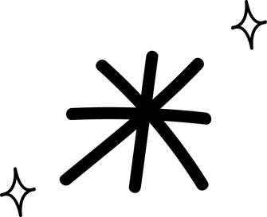
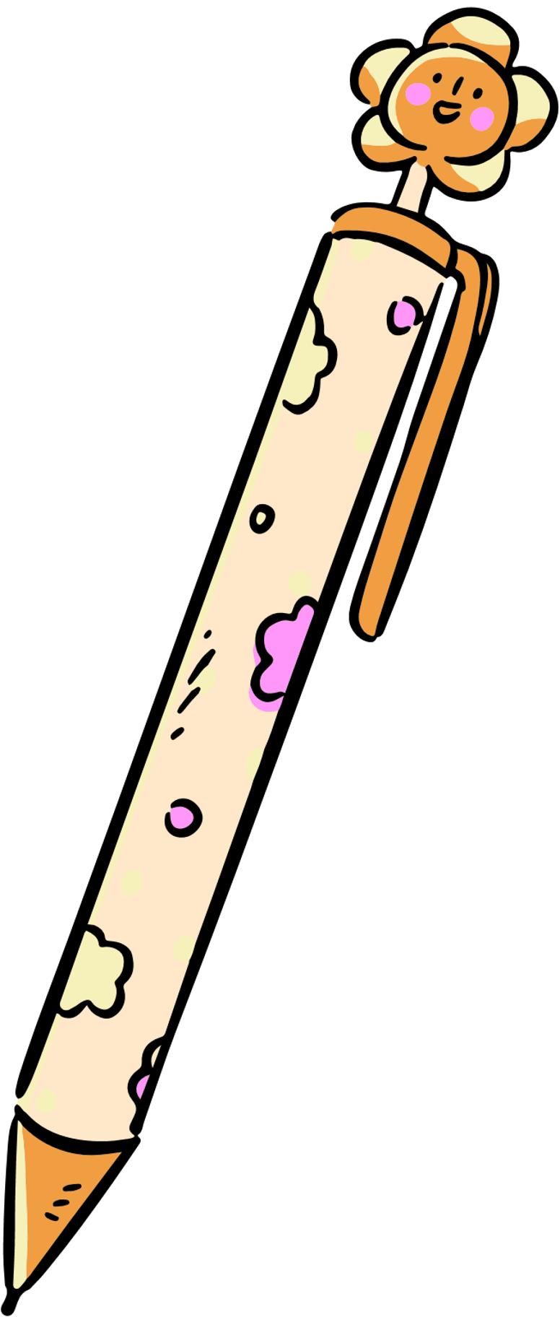
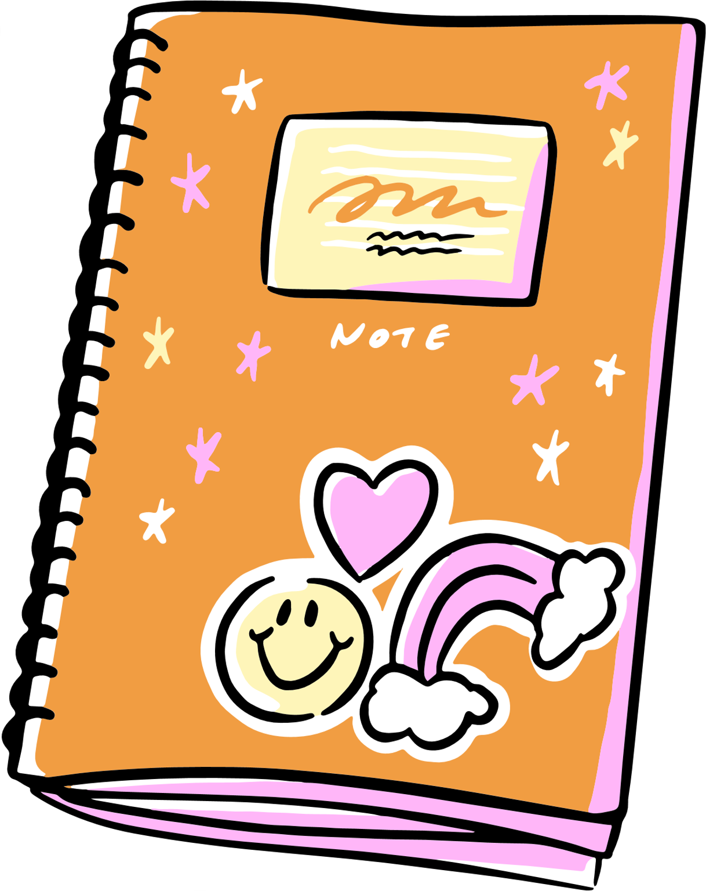
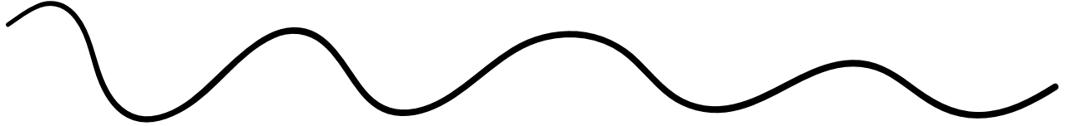

BE KIND

Slide 2


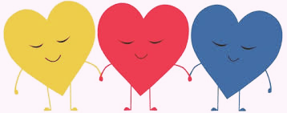
what is Kindness?
Kindness is a trait that fosters positivity, strengthens relationships, and creates a supportive environment.
Kindness is being caring and helpful, it can transform personal and professional interactions to positive outcomes.

Slide 3


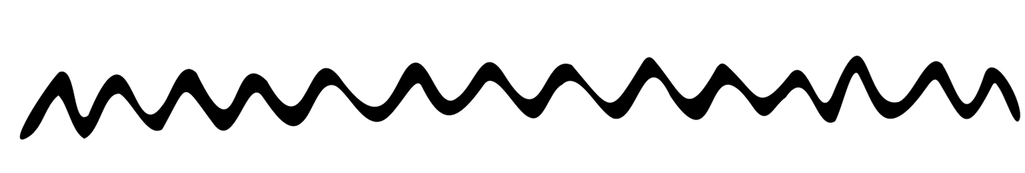
What you’ll learn
Implement daily acts of kindness
Reflect on how our behaviors affect others
Learn the impact kindness can have on an operation
Be able to conduct a self-assessment

Slide 4

what does Kindness mean to you?
Notes:
In this activity, we'll create a visual "Kindness Jar" using a kitchen liner or large sheet of paper. Each table will receive a sticky note and be asked to write down what kindness means to them.
Once everyone is finished, they'll add their sticky notes to the jar. We'll then take a moment to read a few out loud to the group, sharing insights and reflections.
Let’s wrap up with a positive takeaway—highlighting how small acts of kindness can have a big impact on team culture.

Slide 5

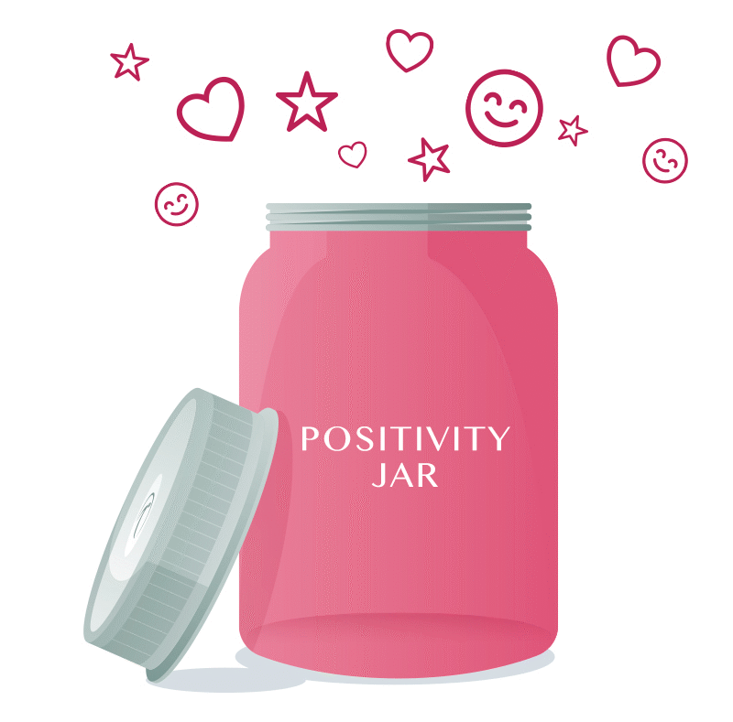
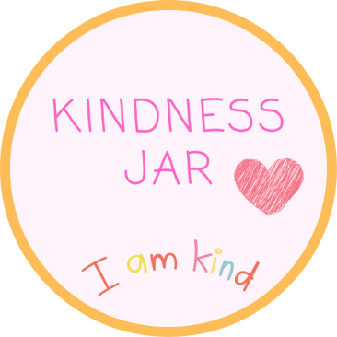
Kindness Jar activity
Using a sticky note, write down what kindness means to you.
Notes:
In this activity, we'll create a visual "Kindness Jar" using a kitchen liner or large sheet of paper. Each table will receive a sticky note and be asked to write down what kindness means to them.
Once everyone is finished, they'll add their sticky notes to the jar. We'll then take a moment to read a few out loud to the group, sharing insights and reflections.
Let’s wrap up with a positive takeaway—highlighting how small acts of kindness can have a big impact on team culture.

Slide 6


Slide 7
daily acts of kindness
Small acts of kindness can be done quickly and have a long-lasting impact. Try simple gestures like:
Offering help
Expressing gratitude
Celebrating small wins and accomplishments
Saying “Good Morning”
Making someone feel valued
Sharing a smile

Slide 8

Non-verbal kindness
Positive body language is a powerful way to show kindness.
A warm smile, eye contact, nodding while listening, and an open posture show you care, even without saying a word.

Slide 9
What other daily acts can you do?
Acts of kindness can inspire others to do the same.
This is known as the “kindness ripple.”
One good deed can spark
many more.
Notes:
In this activity, we’ll create a visual “Kindness Jar” using a kitchen liner or a large sheet of paper. Each table will receive a sticky note and be invited to write down additional everyday acts of kindness they can practice at work. Once everyone has finished, they’ll place their sticky notes inside the jar to fill it with positivity and inspiration

Slide 11
Impacts of kindness
Kindness at work creates a positive environment where everyone feels valued, fostering stronger relationships and a more productive team.

Slide 12

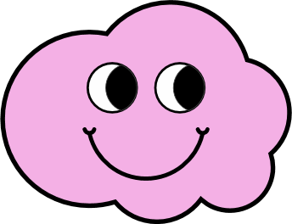
positive work environment
Spreading positivity fosters respect, strengthens teamwork, and brings people closer together.
People feel motivated and engaged when the environment is supportive and upbeat.

Slide 13
Greater employee retention
A positive and supportive workplace makes people feel valued, encourages growth, and increases the likelihood they will stay with the organization.
Notes:
Reducing tranffers can be a talking point.

Slide 14
Increased productivity
An encouraging atmosphere sparks greater motivation, opening team members to new ideas and makes them more resilient in the face of challenges.
It helps buffer against work-related pressures and emotional exhaustion.

Slide 15
Stronger teamwork
When employees feel appreciated and supported, they are more likely to collaborate effectively, building a stronger connected team.
Strong teams stay solutions focus finding solutions rather than blaming.

Slide 16

People don’t leave bad jobs, they leave bad work environments

Slide 17
Grace under pressure
Remaining kind during challenging situations demonstrates true strength and character, and helps maintain a positive, supportive workplace.

Slide 18



Emotional Regulation is Kindness in Action
When you handle your emotions, you create a calmer, safer space for everyone around you.
Know what your triggers are and what sets you off.
You can’t control everything, but you can choose how you show up.
Being kind at work goes beyond how you treat others. It begins with how you manage yourself.
Staying calm under pressure shows respect, self-awareness, and is a key part of practicing kindness.
Notes:
Staying cool under pressure shows respect and self-awareness—both essential to kindness.

Slide 19

Resolve Conflict Mindfully through kindness
Kindness isn’t just about being friendly,
it’s how we show up when things get tough.
Being kind means giving others your
full attention.
Listen to understand, not just to respond.
Following up shows people they matter. It's a simple but powerful act of kindness and accountability.
Kindness to others starts with yourself.
Use calming techniques like 4-7-8 breathing so you can respond, not react.

Slide 20

Kindness is choosing honesty with empathy
Facts create clarity, and kindness makes the conversation safe.
Kindness in Action:
Ask questions before assuming.
Use the 4 W’s:
Who, What, Where, and When.
Kindness isn’t about avoiding the truth,
it’s about how we share it.
When giving feedback, addressing an issue, or solving a problem:
Start with facts, not assumptions.
Use kindness in your tone and delivery.

Slide 21
De-escalation is what kindness looks like under pressure
Kindness isn’t just being nice, it’s how we respond when things get tense.
Kindness starts with self-control. Keep your tone, body language, and voice steady to lower tension.
Recognize emotions without judgment. Listening with empathy shows you care, even when you don’t agree.
Kindness is also about being helpful. Shift the focus to solutions not blame so everyone can move forward.

Slide 22

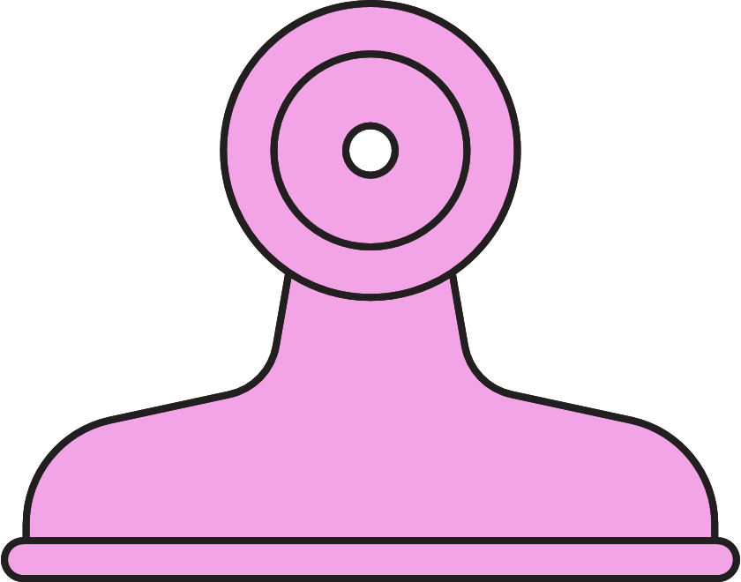
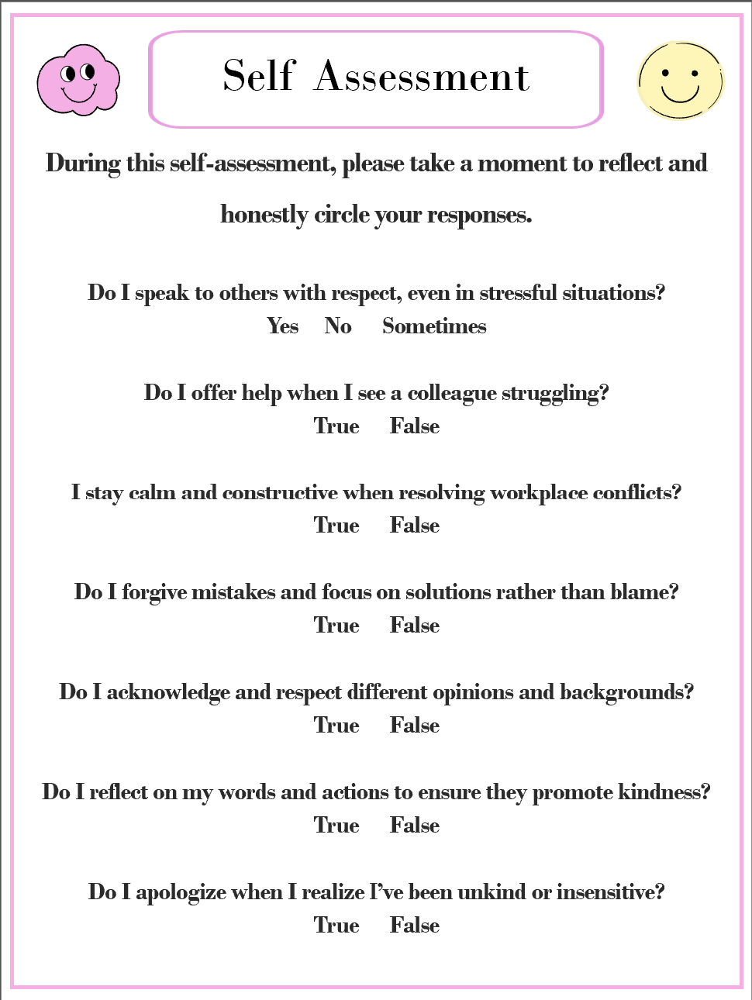
SELF ASSESSMENT
During this assessment take a moment to reflect and honestly answer
these questions.

Slide 24
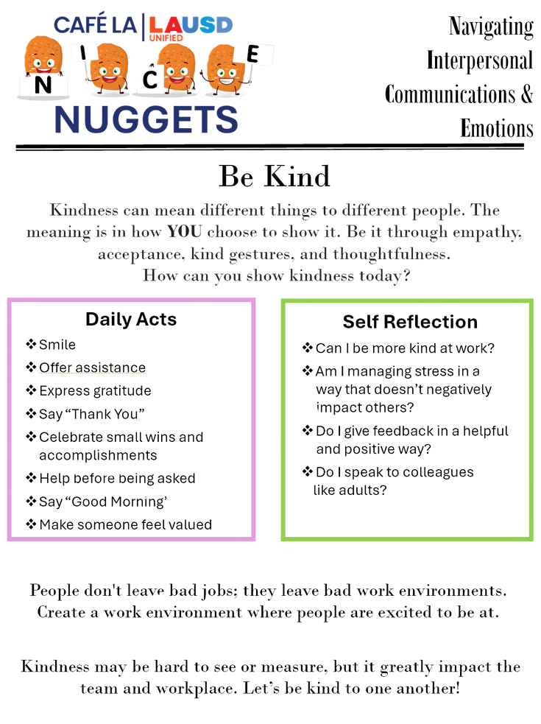
Nuggets
Share the 'NICE NUGGETS' poster with your staff and read it aloud to motivate and engage the team.
Post it in a visible area for your staff to review as they please.

Slide 25
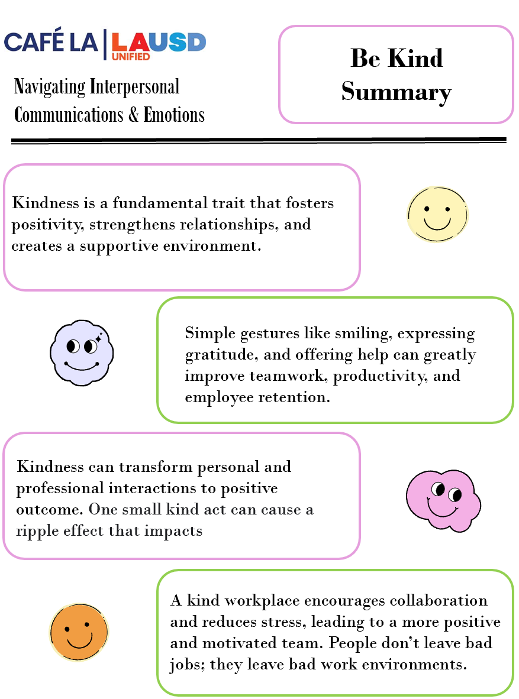
summary

